Slide 1
Populist publics and their penchant for nuclear weapons?
Populist opposition to nuclear weapons use and nuclear sharing arrangements.
Tom W. Etienne (University of Pennsylvania, Erasmus University Rotterdam) Michal Onderco (Erasmus University Rotterdam) Sandra Destradi (Albert-Ludwigs-Universität Freiburg) Andre Krouwel (Free University Amsterdam)
Prepared for the EISS Annual Conference: WMD, Arms Control, and Nonproliferation Panel, Barcelona, Spain, 29-30/6/2023 Project funded through a Stanton Foundation grant "Nuclear Politics in Europe" awarded to Michal Onderco.
tom.etienne@asc.upenn.edu
@TomWEtienne

Slide 2
Content
Context
Expectations
Theory
Methods
Results
Discussion

Slide 3
Populism and foreign policy
Context
Populism only recently a topic of focus in IR
We consider it a thin ideology (Mudde, 2004; Mudde & Rovira Kaltwasser, 2013; Stanley, 2008) so it applies to mass attitudes too
Link to nuclear risk is limited
Focus on populist leaders (Giovaninni, 2018; Gevarter, 2018; Meier & Vieluf, 2021)
Little focus on populist publics (Mead, 2011)
Fails to engage with mechanisms

Slide 4
This paper
Context
How populist attitudes predict two dimensions of nuclear risk
Nuclear weapons use preferences
Nuclear sharing attitudes
Two European nuclear sharing countries: DE & NL
Among the public, using two-wave survey data

Slide 5
Expectations
People that have more populist attitudes will:
Nuclear use preferences
Be more likely to support the use of nuclear weapons (H1a)
Be less likely to support the use of nuclear weapons (H1b)
Nuclear sharing attitudes
Be less supportive of the nuclear sharing arrangement (H2)

Slide 6
Theory: why?
Through mechanisms
Dimensions of populist attitudes
Host ideology
Contextual characteristics
Meier and Vieluf (2021) posit that populists have a special penchant for nuclear weapons

Slide 7
Nuclear use preferences
Theory
Anti-elitism/establishment dimension of populism
Nuclear weapons no longer politicized
Nuclear attitudes insulated from public opinion
Nuclear policy is technical and seen as an elite project
Nuclear policy is opaque and may be prone to conspiratorial thinking (van Prooijen, 2018)
Increased acceptance of (domestic) violence (Uscinski et al., 2021)
Distinct phenomenon with a host ideology
Left-wing populists more pacifist (Coticchia & Vignoli, 2020)
Right-wing populists show more enthusiasm for nuclear weapons (Ostermann & Stahl, 2022)
Right-wing more likely to support nuclear use (Onderco et al., 2022; Etienne, 2022)
Contextual characteristics
Use of weapons against Russia
Higher affinity for Russia (Etienne et al., 2022)
Affinity for strongmen politics, strong leadership

Slide 8
Nuclear use preferences
Theory
More likely
Less likely
Anti-elitism/establishment dimension of populism
Nuclear weapons no longer politicized
Nuclear attitudes insulated from public opinion
Nuclear policy is technical and seen as an elite project
Nuclear policy is opaque and may be prone to conspiratorial thinking (van Prooijen, 2018)
Increased acceptance of (domestic) violence (Uscinski et al., 2021)
Distinct phenomenon with a host ideology
Left-wing populists more pacifist (Coticchia & Vignoli, 2020)
Right-wing populists show more enthusiasm for nuclear weapons (Ostermann & Stahl, 2022)
Right-wing more likely to support nuclear use (Onderco et al., 2022; Etienne, 2022)
Contextual characteristics
Use of weapons against Russia
Higher affinity for Russia (Etienne et al., 2022)
Affinity for strongmen politics, strong leadership

Slide 9
Nuclear sharing attitudes
Theory
Popular sovereignty dimension
US weapons under US protection and command (transferred to NPG)
Anti-globalization sentiments
Bring control back to the people
Weapons are ‘imposed’ on the people
Anti-elitism dimension
Hostility to international elites
To the US, to Brussels

Slide 10
Methods
Two-wave panel data
June 2022
May 2023
Germany & Netherlands (total n = 6438)
Weighted data

Slide 11
Methods
Dependent variables
Nuclear use preferences → OLS regression
Index of 6pt Likert scales on four use scenarios
Nuclear sharing attitudes → multinomial regression
In favour of nuclear withdrawal, but not with US reinforcements
Independent variables
Index of populist attitudes (8 items, alpha = 0.91)
Anti-elitism and popular sovereignty captured
Demographic controls
Political controls
Left-right self-placement (+ vote recall)

Slide 12
Populist attitudes
Results

Slide 13
Nuclear use preferences & populism
Results

Slide 14
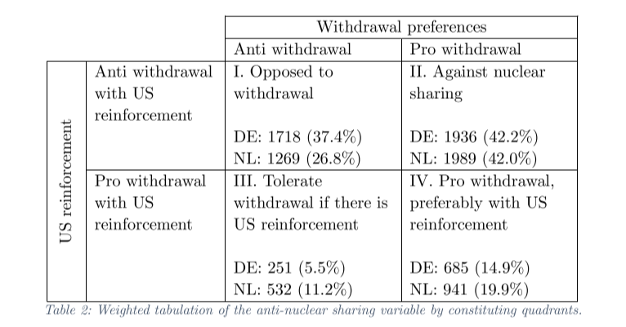
Nuclear sharing descriptives
Resuls

Slide 15
Nuclear sharing & populism

Slide 16
Some considerations
Discussion
Study of the public instead of elites
Populist leaders are not in power in DE/NL
Nuclear sharing states vs NWS/NNWS

Slide 17
Implications
Discussion
Populists’ proclivity for nuclear use may be context dependent
While Russia remains sole realistic target, support may depend on Russian regime, domestic regime, and US regime.

Slide 18
Future improvements
Discussion
Control for additional explanations with alternative data
Isolationism
Better models for longitudinal data, closer to causal identification
Fixed effects
Pay closer attention to the interaction with LR-ideology
Parse out contextual factors’ effects
Introduce an experiment where we vary Russia as the target in the use scenarios
Perhaps experiment to causally identify effect,
But also to see if Russia is the determining factor

